Slide 1
CIS 7 – Discrete Structures
Fall 2017 – Norco College – Mr. James Wilson

Slide 2
What are Discrete Structures
“Discrete structures are foundational material for computer science. By foundational we mean that relatively few computer scientists will be working primarily on discrete structures, but that many other areas of computer science require the ability to work with concepts from discrete structures. Discrete structures include important material from such areas as set theory, logic, graph theory, and combinatorics.”
-Wikipedia

Slide 3
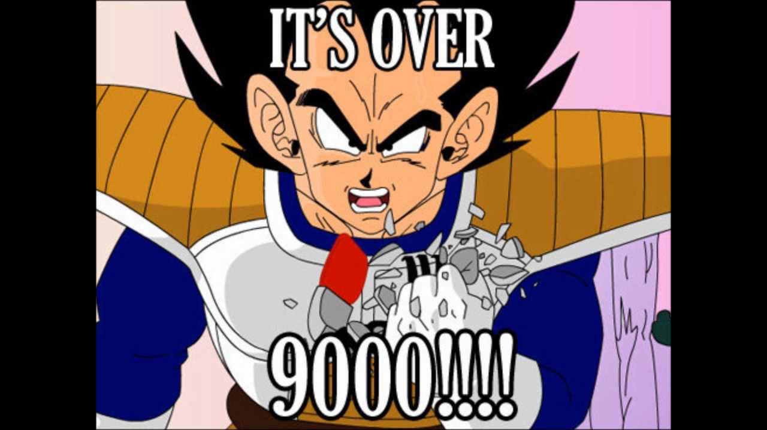
No Really, What is it?
Basically, the study of structures that are NOT continuous
Number of students in this classroom?
Discrete
The speed of your car?
Continuous
Goku’s Power Level?
Discrete (Over 9000)

Slide 4
Six Key Topics
Logic
Proofs
Set Theory
Counting
Graph & Tree Theory
Probability

Slide 5
Section 1: Logic (Weeks 1, 2, & 3)
Propositional Logic
Predicate Logic
Equivalences
Tautologies

Slide 6
Section 2: Proofs
Inference
Deduction
Techniques

Slide 7
Section 3: Set Theory
Native set theory
Operating on sets
Proofs

Slide 8
Section 4: Counting
Equality
Inequality
Binomials
Functions

Slide 9
Section 5: Graphs & Trees
Basics
Graph Theory
Cycles
Traversing graphs
Proofs

Slide 10
Section 6: Probability
Events
Variables
Functions

Slide 11
Textbook
“Mathematical Structures For Computer Science: 7th Edition”, Gersting, Judith L.
Is it required?
It’s extremely helpful
You will know the material if you read
It’s dense
It Depends
You can access all of the topics online. However, you must be disciplined

Slide 12
Homework
Due Weekly
Varies based on classroom participation
Varies on classroom size
Submitted via GitHub

Slide 13
Exams
Due dates vary based on how quickly we cover material, but you can be assured to have plenty of notice.
Exams are, essentially, projects to be completed at home or in lab and presented to the class.
Projects will present the side benefit of continuing learning to code.

Slide 14
Potential Schedule
Week | Week Start Date | Subject Material | Chapter Reading/Assignments
Week 1 | 8/28 | Propositional Logic | 1.1 – 1.3
Week 2 | 9/4 | Predicate Logic, Correctness | 1.4 – 1.6
Week 3 | 9/11 | Programming Exercises | Chapter 1 “On The Computer”
Week 4 | 9/18 | Proofs, Induction | 2.1 – 2.2
Week 5 | 9/25 | Correctness, Number Theory | 2.3 – 2.4
Week 6 | 10/2 | Programming Exercises | Chapter 2 “On the Computer”
Week 7 | 10/9 | Recursion & Recurrence | 3.1 – 3.2
Week 8 | 10/16 | Analysis of Algorithms | 3.3
 | 10/23 | Holiday | No Classes
Week 10 | 10/30 | Programming Exercises | Chapter 3 “On the Computer”
Week 11 | 11/6 | Sets, Combinatorics & Probability | Chapter 4
Week 12 | 11/13 | Programming Exercises | Chapter 4 “On the Computer”
Week 13 | 11/20 | Graphs & Trees | 6.1 – 6.3
Week 14 | 11/27 | Graph Algorithms | Chapter 7
Week 15 | 12/4 | Graph Algorithms (cont’d) | Chapter 7
Final | 12/11 |  | Final Exam

Slide 15
Questions?
james.wilson@rccd.edu
No office hours. However, I will accommodate requests for scheduled one-on-one time before or after class.
Discussion & Participation amongst students is highly encouraged

